Slide 1
Unit - III
Components and Layout
(8 Hrs – 8 Marks)

Slide 2
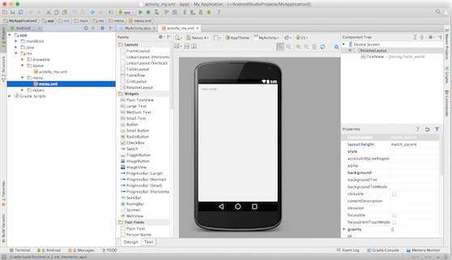
Create Android Application

Slide 3
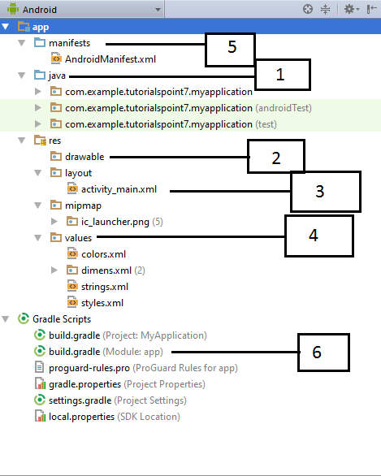
Directory Structure….

Slide 4
1.Java folder
storing all of the source code files written in Java programming language.
A MainActivity.java is automatically created in this folder by Android Studio. All of your classes will be available here
2.Res folder :
Resources basically mean all the needed files except the source code. For example, while developing an app, you need to include resource files such as the app-logo, photos, sounds, videos
For every resource that you include in your Android project, the SDK build tools define a unique integer ID, which you can use to reference the resource
R.java file
It is the auto-generated file that contains IDs for all the resources of res directory. It is generated by aapt(Android Asset Packaging Tool).
Whenever you create any component on activity_main, a corresponding ID is created in the R.java file which can be used in the Java Source file later.
For example, if your app contains an image file named logo.png(saved in res/drawable / directory) SDK tools generate a resource ID named R.drawable.logo
Reason of providing resources separate from your source code is the ability to provide alternative resources for different device configurations.
Eg : For example, by defining UI strings in XML, you can translate the strings into other languages and save those strings in separate files.
The following are the folders that can be used inside of the res folder:

Slide 5
1. res/drawable-
The drawable folder contains graphics that can be drawn to the screen. e.g. images files (png, jpg and gif)
2. res/layout
The layout folder contains XML files used for your layouts.
activity_main.xml is automatically created in this folder by Android Studio. Layout folder may have multiple layout folders to handle different devices.
3. res/Mipmap :
The mipmap folder contains the launcher icon files for the app. A launcher icon is a graphic that represents your app to users.
4. res/values
The values folder contains XML files that contain simple values, such as strings, integers, and colors. The values folder is used to keep track of the values you will be using in your application.
the following XML files will be generated automatically:
colors.xml
strings.xml :
it contains all the text that your application uses. For example, the names of buttons, labels, default text,
Eg :<resources> <string name="app_name">M H S S P </string>
styles.xml

Slide 6
5. AndroidManifest.xml
This is the manifest file which describes the fundamental characteristics of the app and defines each of its components.
6 . Build.gradle (build tool used by android studio)
Apk files are built using the gradle build system, which is integrated in the Android Studio. When we start an app, the gradle build scripts are automatically created.

Slide 7
The Main Activity File
The main activity code is a Java file MainActivity.java. This is the actual application file which ultimately gets converted to a Dalvik executable and runs your application
The Manifest File
The AndroidManifest.xml file contains information of your package, including components of the application such as activities, services, broadcast receivers, content providers etc.
you must declare all its components in a manifest.xml which resides at the root of the application project directory.
it contains information on which part of the app can be launched, which is a service or a receiver, what permissions the apps needs, what hardware and software features the app needs, which version of Android is compatible with it etc.

Slide 8
Elements of the AndroidManifest.xml file
<application>
This element contains several sub elements that declares the application component such as activity etc.
The commonly used attributes are :
android:icon represents the icon for all the android application components.
android:label works as the default label for all the application components.
android:theme represents a common theme for all the android activities.
<activity>
represents an activity that must be defined in the AndroidManifest.xml file.
The commonly used attributes are :
android:label represents a label i.e. displayed on the screen.
android:name represents a name for the activity class.

Slide 9
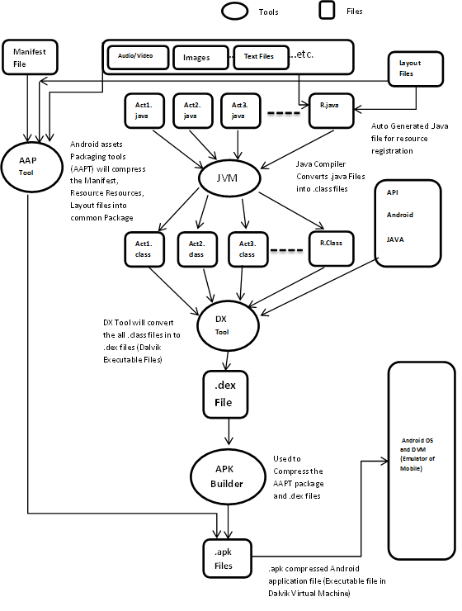
Control Flow

Slide 10
.All resource files are combined together by AAP[Android Asset Packing Tool]. Resource files are like audio video images other asset related files.
.Java files converted into .class files by JVM.So, the out of the jvm will be .class files
Class files are entered as input to DX tool. Basically, this is a tool which will convert .class files to .dex files. That mean Dalvik executable file. Those files are eligible to execute on DVM (Dalvik Virtual Machine)
After getting .dex files, packed them APK builder. Which is basically, Application Packaging. So, this packed files kept into devices and that will be executed by DVM.

Slide 11
Fundamental UI design
A View is an object that draws something on the screen that the user can interact with and a ViewGroup is an object that holds other View (and ViewGroup) objects in order to define the layout of the user interface.
The basic building block for user interface is a View object which is created from the View class and occupies a rectangular area on the screen
View is the base class for widgets, which are used to create interactive UI components like buttons, text fields, etc.
You define your layout in an XML file which offers a human-readable structure for the layout, similar to HTML

Slide 12
Android UI Controls
1TextViewThis control is used to display text to the user.
2EditTextEditText is a predefined subclass of TextView that includes rich editing capabilities.
4ButtonA push-button that can be pressed, or clicked, by the user to perform an action.
5ImageButtonAn ImageButton is an AbsoluteLayout which enables you to specify the exact location of its children. This shows a button with an image (instead of text) that can be pressed or clicked by the user.
6CheckBoxAn on/off switch that can be toggled by the user. You should use check box when presenting users with a group of selectable options that are not mutually exclusive.
7ToggleButtonAn on/off button with a light indicator.
8RadioButtonThe RadioButton has two states: either checked or unchecked.
9RadioGroupA RadioGroup is used to group together one or more RadioButtons.

Slide 13
Layout for UI design
There are number of Layouts provided by Android which you will use in almost all the Android applications to provide different view, look
1Linear LayoutLinearLayout is a view group that aligns all children in a single direction, vertically or horizontally.
2Relative LayoutRelativeLayout is a view group that displays child views in relative positions.
3Table LayoutTableLayout is a view that groups views into rows and columns.
4Absolute LayoutAbsoluteLayout enables you to specify the exact location of its children.
5Frame LayoutThe FrameLayout is a placeholder on screen that you can use to display a single view.

Slide 14
Layout attributes…
Each layout has a set of attributes which define the visual properties of that layout.
1.android:id
This is the ID which uniquely identifies the view.
2android:layout_width
This is the width of the layout.
3android:layout_height
This is the height of the layout
4android:layout_marginTop
This is the extra space on the top side of the layout.

Slide 15
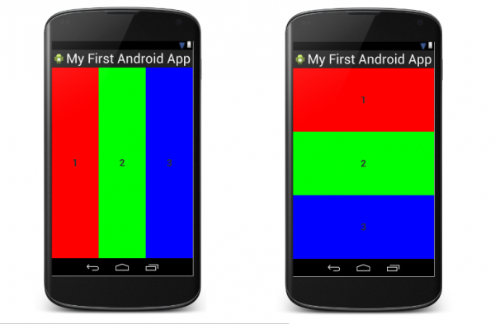
Linear Layout
is a view group that aligns all children in a single direction, vertically or horizontally. You can specify the layout direction with the android:orientation attribute
1.Vertical:In this all the child are arranged vertically in a line one after the other.
<LinearLayout xmlns:android="http://schemas.android.com/apk/res/android" android:layout_width="fill_parent" android:layout_height="wrap_content" android:orientation="vertical"> <!-- Vertical Orientation set -->
1.Horizontal:In this all the child are arranged horizontally in a line one after the other.

Slide 16
Main Attributes In Linear Layout
android: orientation: The orientation attribute used to set the childs/views horizontally or vertically. In Linear layout default orientation is vertical.
android:layout_width : specify width of the layout.
android:layout_height:specify height of the layout
a. android:layout_width=“wrap_content”
If you set layout width or height as wrap_content it will use space big enough for its contents to get enclosed.
b. android:layout_height=“ match_parent” / “fill_parent”
When you set layout width and height as match_parent, it will occupy the complete area that the parent view has, i.e. it will be as big as the parent.
Note :
fill_parent was used in previous versions, but now it has been deprecated and replaced by match_parent .
our parent view in a Layout with height and width set as match_parent therefore it will cover the whole screen of mobile. So the complete screen is our parent view.

Slide 17
android:layout_gravity is used to specify how the control(view) object is aligned in the layout.
android:gravity is used to specify how the text in the control (view) is aligned.
Eg : android:gravity="right“
android : layout_weight: specifies how much of the extra space in the layout to be allocated to the View.
defines the weight of each control occupying the remaining screen space.
means the child with larger weight will be allow to expand more.
Eg :
<Button android:layout_width="wrap_content" android:layout_height="wrap_content" android:text="Weight 2" android:background="#761212" android:layout_margin="5dp" android:id="@+id/button" android:layout_weight="2" />
android:weightSum defines the maximum weight sum,
It is generally defined in the parent layout to constrain the layout_weight attribute of the child layout.
it is calculated as the sum of the layout_weight of all the children if not specified explicitly.

Slide 18
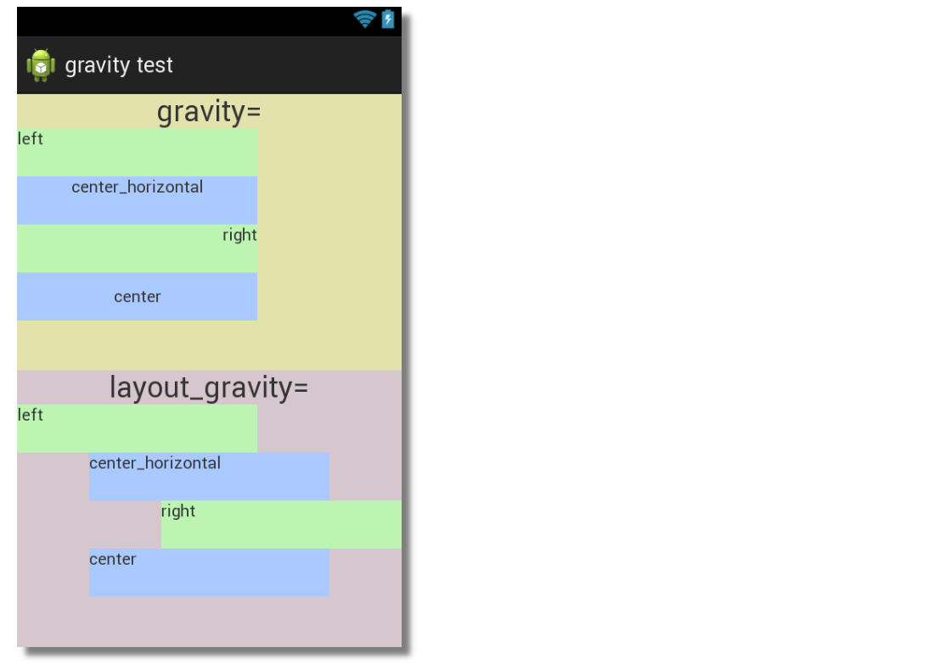
Example of
gravity and layout_gravity

Slide 19
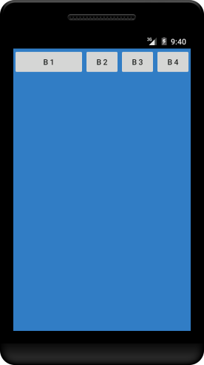
Weight and WeightSum example
<LinearLayout xmlns:android="http://schemas.android.com/apk/res/android"
android:layout_width="match_parent"
android:layout_height="match_parent"
android:background="@color/slate_blue"
android:orientation="horizontal"
android:weightSum="5">
<Button
android:id="@+id/button1"
android:layout_width=“wrap_content"
android:layout_height="wrap_content"
android:layout_weight="2“
anroid:layout_margin=“5dp”
android:text="B 1" />
<Button
android:id="@+id/button2“
android:layout_width=“wrap_content"
android:layout_height="wrap_content“
anroid:layout_margin=“5dp”
android:layout_weight="1"
android:text="B 2" />

Slide 20
Continue…
<Button
android:id="@+id/button3"
android:layout_width="0dp"
android:layout_height="wrap_content"
android:layout_weight="1“
anroid:layout_margin=“5dp”
android:text="B 3" />
<Button
android:id="@+id/button4"
android:layout_width="0dp"
android:layout_height="wrap_content“
anroid:layout_margin=“5dp”
android:layout_weight="1"
android:text="B 4" />
</LinearLayout>
button B1 is given a weight of 2 such that it occupies 2/5 of the screen width. The others, with a weight of 1, occupy 1/5 of the screen each.

Slide 21
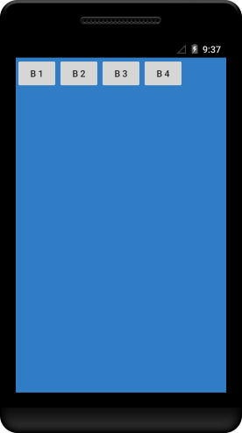
Continue…
NOTE : The sum of the weights, does not
have to equal the weightsum.
In the example above, if the first button is
given the weight of one, then it will occupy
1/5 of the screen and all four buttons will
occupy 4/5 of the screen

Slide 22
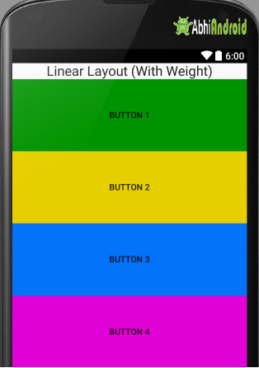
Linear layout with weight example…
<!-- Horizontal Orientation is set with weightSum-->
<LinearLayout xmlns:android="http://schemas.android.com/apk/res/android"
android:layout_width="match_parent"
android:layout_height="match_parent"
android:weightSum="5"
android:orientation=“horizontal">
<!-- Text Displayed At Top -->
<TextView
android:layout_width=“match_parent"
android:layout_height="wrap_content"
android:text="Linear Layout (With Weight)"
android:id="@+id/textView"
android:layout_gravity="center_horizontal"
android:layout_weight="0"/>

Slide 23
<!-- Button Used -->
<Button
android:layout_width="fill_parent"
android:layout_height="wrap_content"
android:text="Button 1"
android:background="#009300"
android:layout_weight="1"/>
<Button
android:layout_width="fill_parent"
android:layout_height="wrap_content"
android:text="Button 2"
android:background="#e6cf00"
android:layout_weight="1"/>

Slide 24
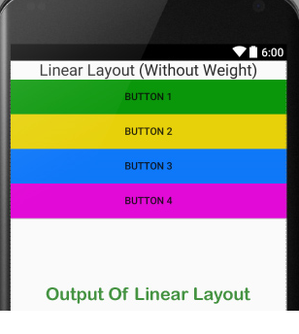
Linear layout without Weight example…
<!-- Horizontal Orientation is set without weight-->
<LinearLayout xmlns:android="http://schemas.android.com/apk/res/android"
android:layout_width="match_parent"
android:layout_height="match_parent"
android:orientation=“horizontall">
<!-- Text Displayed At Top -->
<TextView
android:layout_width="wrap_content"
android:layout_height="wrap_content"
android:text="Linear Layout (Without Weight)"
android:id="@+id/textView"
android:layout_gravity="center_horizontal“/>
<Button
android:layout_width="fill_parent"
android:layout_height="wrap_content"
android:text="Button 1"
android:background="#009300“ />

Slide 25
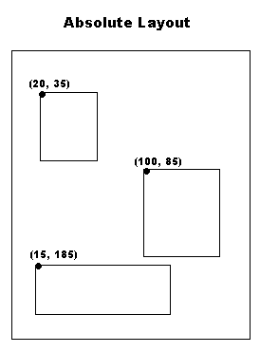
Absolute layout
An Absolute Layout lets you specify exact locations (x/y coordinates) of its children.
Absolute layouts are less flexible and harder to maintain than other types of layouts without absolute positioning
Absolute layout are harder to maintain for different
mobile screen sizes because we set the exact location of a
child view or called component. The positioning is based on
x(top) and y(left) coordinates and that positioning is not
as useful on different mobile devices of various screen resolutions(sizes)

Slide 26
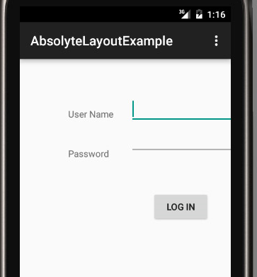
try opening the same layout in different size Emulator and you will see it doesn’t fit in different size device. That’s why Android has depreciated the use of Absolute Layout.

Slide 27
Absolute Layout Attributes
1android:id
This is the ID which uniquely identifies the layout.
2android:layout_x
This specifies the x-coordinate of the view.
3android:layout_y
This specifies the y-coordinate of the view.

Slide 28
Relative Layout…
It gives us the flexibility to position our component/view based on the relative or sibling component’s position.
Attributes of Relative layout:

Slide 29
Relative Layout
Center
Align By
Relative to
Parent View
Parent View
Sibling View
Relative to
Sibling View
CenterHorizontal
CenterVertical
CenterInParent
AlignParentTop
AlignParentBottom
AlignParentRight
AlignParentLeft
AlignTop
AlignBottom
AlignLeft
AlignRight
AlignBaseLine
ToLeftOf
TorightOf
Above
Below

Slide 30
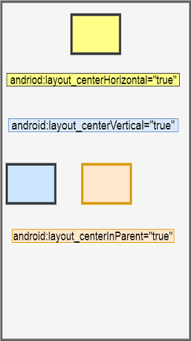
Center relative to Parent View
android:layout_centerHorizontal="true"This places
the view horizontally in the center of the parent.
android:layout_centerVertical="true"This places
the view vertically in the center of the parent.
android:layout_centerInParent="true"This
attribute will place the view in the center
of the parent.

Slide 31
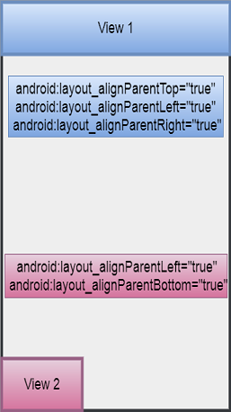
Align by the parent view These type of attributes make the view act like a chewing gum as it can be fixed to any side of the parent view using these attributes.
android:layout_alignParentTop="true“
If you write this attribute for a View,
then that view will stick to the top of its parent.
android:layout_alignParentBottom="true“
If you write this attribute for a View,
then that view will stick to the bottom of its parent.
android:layout_alignParentLeft="true“
If you write this attribute for a View,
then that view will stick to the left of its parent.
android:layout_alignParentRight="true"If you write this attribute for a View, then that view will stick to the right of its parent.

Slide 32
Align by the parent view
Note: You can always use more than one of
these attributes.
eg
eandroid:layout_alignParentLeft="true“
and android:layout_alignParentBottom="true“
then the view will stick to
the bottom-left corner of the screen

Slide 33
Relative layout…. Place new View relative to existing sibling View
android:layout_toLeftOf="@id/main"This tells the new view that you have to be on the left side of the view whose id is main
android:layout_toRightOf="@id/main"This tells the new view that you have to be on the right side of the view whose is main
android:layout_above="@id/main"This tells the new view that you have to be above the view whose id is main
android:layout_below="@id/main"This tells the new view that you have to be below the view whose id is main
Note: When you assign an id to the View, you write android:id="@+id/main" i.e you write a + sign after the @ symbol, indicating you are assigning an id to that view.
But when you use that id for other purpose, like above, you are adding a new view relative to an existing view having the specified value of id, hence we do not have to mention the + sign.

Slide 34
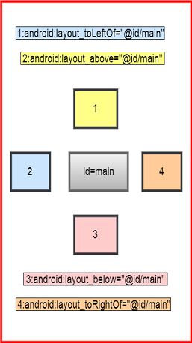
Relative layout…. Place new View relative to existing sibling View

Slide 35
Relative Layout…. Align new View relative to existing sibling View
android:layout_alignTop="@id/a"This aligns the top margin of the new view with the top margin of the view having id as a.
android:layout_alignBottom="@id/a"This aligns the bottom margin of the new view with the bottom margin of the view having id as a.
android:layout_alignLeft="@id/a"This aligns the left margin of the new view with the left margin of the view having id as a.
android:layout_alignRight="@id/a"This aligns the right margin of the new view with the right margin of the view having id as a
android:layout_alignBaseLine="@id/a"This aligns the text2 of the new view with the text1 of the view having id as a.

Slide 36
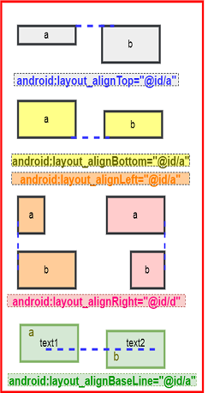
Relative Layout…. Align new View relative to existing sibling View

Slide 37
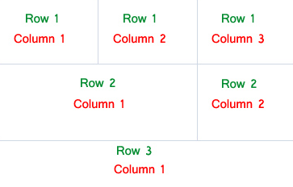
Table Layout
It is used to arrange the group of views into rows and
columns.
For building a row in a table we will use the <TableRow> element.
Table row objects are the child views of a table layout.
Each row of the table has zero or more cells and each cell can hold only one view object like ImageView, TextView
Total width of a table is defined by its parent container.
Column can be both stretchable and shrinkable. If shrinkable then the width of column can be shrunk to fit the table into its parent object and
if stretchable then it can expand in width to fit any extra space available.

Slide 38
Table Layout attributes…
StretchColumns: Stretch column attribute is used in Table Layout to Stretch width of a column.
The value that assigned to this attribute can be a single column number or a comma delimited list of column numbers (1, 2, 3…n).
If the value is 1 then the second column is stretched to take up any available space in the row, because of the column numbers are started from 0.
If the value is 0,1 then both the first and second columns of table are stretched
If the value is ‘*’ then all the columns are stretched to take up the available space.

Slide 39
collapseColumns: collapse columns attribute is used to collapse or invisible the column’s of a table layout. These columns are the part of the table information but are invisible.
If the values is 0 then the first column appears collapsed, i.e it is the part of table but it is invisible.
Layout_column : represent index of the column in which the child should be

Slide 40
Table layout StretchCoulmn example ……
<TableLayout xmlns:android="http://schemas.android.com/apk/res/android"
android:id="@+id/simpleTableLayout"
android:layout_width="match_parent"
android:layout_height="match_parent"
android:stretchColumns="1"> <!-- stretch the second column of the layout-->
<!-- first row of the table layout-->
<TableRow
android:id="@+id/firstRow"
android:layout_width=“match_parent"
android:layout_height="wrap_content">
<!-- first element of the row-->
<TextView
android:id="@+id/simpleTextView"
android:layout_width="wrap_content"
android:layout_height="wrap_content“
android:text="Text 1“
android:layout_column=1 / >

Slide 41
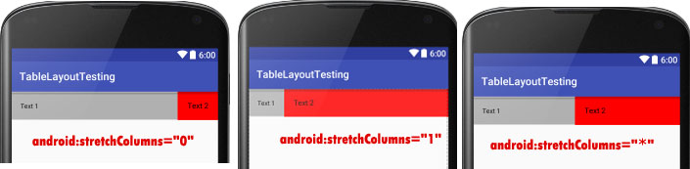
Continue…. Table layout StretchCoulmn example
<!-- second element of the row-->
<TextView
android:id="@+id/simpleTextView"
android:layout_width="wrap_content"
android:layout_height="wrap_content“
android:text="Text 2“
android:layout_column=2/ >
</TableRow>
</TableLayout>

Slide 42
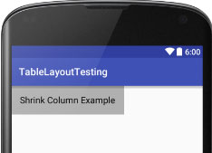
Table layout ShrinkColumn example ……
<TableLayout xmlns:android="http://schemas.android.com/apk/res/android"
android:id="@+id/simpleTableLayout"
android:layout_width="match_parent"
android:layout_height="match_parent"
android:shrinkColumns=“0"> <!– shrink the first column of the layout-->
<TableRow
android:id="@+id/firstRow"
android:layout_width="fill_parent"
android:layout_height="wrap_content">
<!-- first element of the row-->
<TextView
android:id="@+id/simpleTextView"
android:layout_width="wrap_content"
android:layout_height="wrap_content“
android:text="Shrink Column Example"/ >

Slide 43
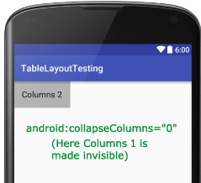
Table layout collapsCoulmn example ……
<TableLayout xmlns:android="http://schemas.android.com/apk/res/android"
android:layout_width="match_parent"
android:layout_height="match_parent"
android:collapseColumns="0"> <!-- collapse the first column of the table row-->
<!-- first row of the table layout-->
<TableRow
android:id="@+id/simpleTableLayout"
android:layout_width="fill_parent"
android:layout_height="wrap_content">
<!-- first element of the row that is the part of table but it is invisible-->
<TextView
android:text="Columns 1“
<!-- second element of the row that is shown in the screenshot-->
<TextView
android:text="Columns 2“ / >
</TableRow>
</TableLayout>

Slide 44
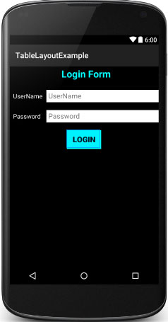
TableLayout Example In Android Studio:
display a login form with two fields
user name and password and one
login button and whenever a user
click on that button a message will
be displayed by using a Toast.

Slide 45
<TableLayout xmlns:android="http://schemas.android.com/apk/res/android"
android:layout_width="match_parent"
android:layout_height="match_parent“
android:stretchColumns="1">
<TableRow
<TextView
android:layout_height="wrap_content“
android:gravity="center_horizontal"
android:text=“LOGIN FORM“
</TableRow>
<TableRow
<TextView
android:layout_height="wrap_content"
android:layout_column="0“
android:text="@string/userName“ / >
<EditText
android:id="@+id/userName"
android:layout_height="wrap_content"
android:layout_column="1“
android:hint="@string/userName“ / >
</TableRow>

Slide 46
<TableRow>
<TextView
android:layout_height="wrap_content"
android:layout_column="0“
android:text="@string/password“ / >
<EditText
android:id="@+id/password"
android:layout_height="wrap_content"
android:layout_column="1“
android:hint="@string/password“ / >
</TableRow>
<TableRow>
<Button
android:id="@+id/loginBtn"
android:layout_height="wrap_content"
android:layout_gravity="center“
android:text="@string/login“ / >
</TableRow>
</TableLayout>

Slide 47
MainActivity.java
public class MainActivity extends AppCompatActivity {
@Override
protected void onCreate(Bundle savedInstanceState) {
super.onCreate(savedInstanceState);
setContentView(R.layout.activity_main);
// initiate a button
Button loginButton = (Button) findViewById(R.id.loginBtn);
// perform click event on the button
loginButton.setOnClickListener(new View.OnClickListener() {
@Override
public void onClick(View v) {
Toast.makeText(getApplicationContext(), "Hello World..!!!", Toast.LENGTH_LONG).show(); // display a toast message
}
});
}

Slide 48
Frame layout
Frame Layout is designed to block out an area on the screen to display a single child view.
however, add multiple children to a FrameLayout and control their position within the FrameLayout by assigning gravity to each child,
It allows User Interface view to be overlapped with each other.
Example : placing a TextView over an ImageView.
You can have multiple view within a frame layout.
In FrameLayout, all the child views added are placed like stack. The most recent added are shown on top. Hence the order of elements in the layout is of importance.
FrameLayout can become more useful when elements are hidden and displayed programmatically

Slide 49
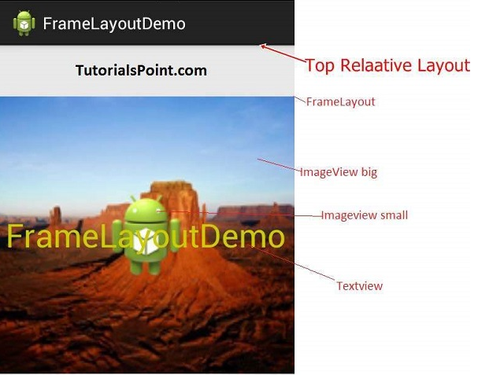

Slide 50
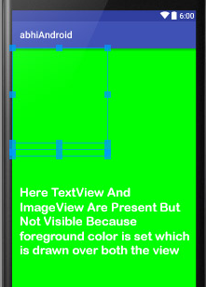
Frame layout attributes…
android:foreground
Foreground defines the drawable to draw over the content and this may be a color value
all the views taken in the framelayout will goes to the background and the framelayout comes in the foreground i.e. over the views..
The value of this property can be a color, a drawable file or a simple image.
android:foregroundGravity
This defines the gravity to apply to the foreground drawable. Default value of gravity is fill. other are : center , top , left , right

Slide 51
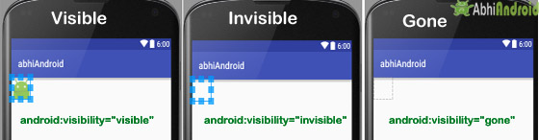
android:visibility
This determine whether to make the view visible, invisible or gone.
visible – the view is present and also visible
invisible – The view is present but not visible
gone – The view is neither present nor visible

Slide 52
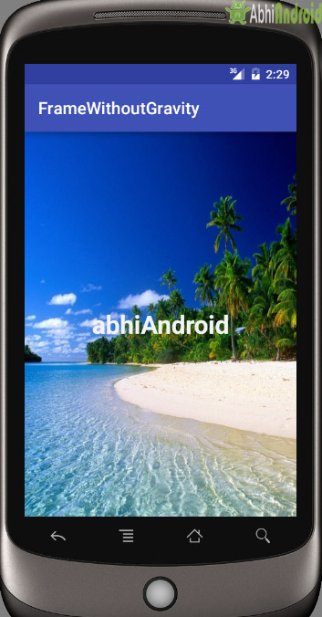
Frame Layout example 1:
<FrameLayout xmlns:android="http://schemas.android.com/apk/res/android"
android:id="@+id/frameLayout"
android:layout_width="fill_parent"
android:layout_height="fill_parent">
<ImageView
android:layout_width="match_parent"
android:layout_height="match_parent“
android:src="@drawable/img_name" />
<TextView
android:layout_width="fill_parent"
android:layout_height="fill_parent"
android:gravity="center"
android:text="abhiAndroid"
android:textSize="30sp"
android:textColor="#f3f3f3"
android:textStyle="bold" />
</FrameLayout>

Slide 53
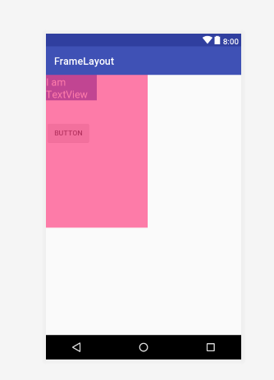
Frame Example 2 :
<FrameLayout
android:layout_width="200dp"
android:layout_height="300dp"
android:foreground="@color/colorAccent“>
<Button
android:layout_width="wrap_content"
android:layout_height="wrap_content"
android:layout_marginTop="90dp"
android:text="Button"/>
<TextView
android:layout_width="100dp"
android:layout_height="50dp"
android:textSize="20sp"
android:background="@color/colorPrimary"
android:textColor="#fff"
android:text="I am TextView" />
</FrameLayout>

Slide 54
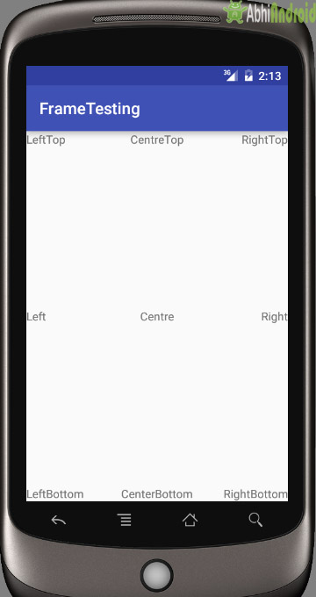
Frame Layout using layout gravity. Example : put textview at different position in Frame Layout.
<FrameLayout xmlns:android="http://schemas.android.com/apk/res/android"
android:layout_height="match_parent"
android:layout_width="match_parent“ >
<TextView android:text="LeftTop“
android:layout_gravity=“Left|top"
android:layout_width="wrap_content"
android:layout_height="wrap_content" />
<TextView android:layout_height="wrap_content"
android:layout_width="wrap_content"
android:text="RightTop"
android:layout_gravity="top|right" />
<TextView android:layout_height="wrap_content"
android:layout_width="wrap_content"
android:text="CentreTop"
android:layout_gravity="top|center_horizontal" />

Slide 55
File: MainActivity.java
package first.javatpoint.com.welcome;
import android.support.v7.app.AppCompatActivity;
import android.os.Bundle;
public class MainActivity extends AppCompatActivity {
@override
protected void onCreate(Bundle savedInstanceState) {
super.onCreate(savedInstanceState);
setContentView(R.layout.activity_main);
} }
@Override indicates that the MainActivity doesn't use the AppCompatActivity class's prewritten onCreate method. Instead, the MainActivity contains a declaration for its own onCreate method.
Activity is a java class that creates and default window on the screen where we can place different components such as Button, EditText, TextView,
It provides life cycle methods for activity such as onCreate, onStop, OnResume etc.
onCreate method is called when Activity class is first created.
setContentView(R.layout.activity_main) gives information about our layout resource. Here, our layout resources are defined in activity_main.xml file.

Slide 56
onCreate(Bundle savedInstanceState) Function in Android:
When an Activity first call or launched then onCreate(Bundle savedInstanceState) method is responsible to create the activity.
When ever orientation(i.e. from horizontal to vertical or vertical to horizontal) of activity gets changed or when an Activity gets forcefully terminated by any Operating System then savedInstanceState i.e. object of Bundle Class will save the state of an Activity.
After Orientation changed then onCreate(Bundle savedInstanceState) will call and recreate the activity and load all data from savedInstanceState.
Basically Bundle class is used to stored the data of activity whenever above condition occur in app.

Slide 57
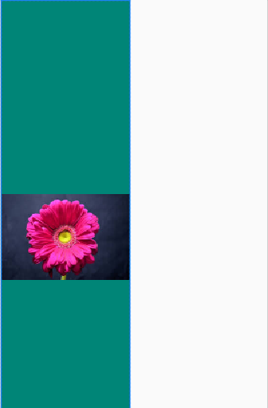
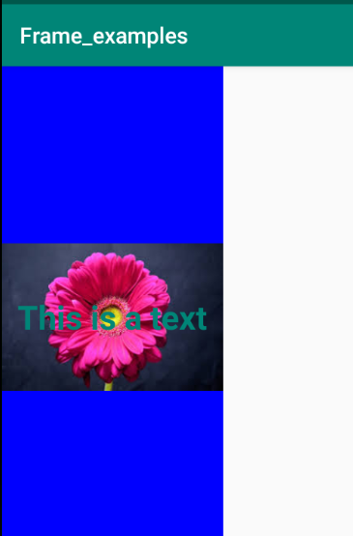
FrameLayout Example 3 : Displaying Text by Clicking on Image
android:id="@+id/frame"
android:layout_width="200dp“
android:background="@color/colorPrimary"
android:layout_height="match_parent“ >
<ImageView
android:id="@+id/frameImage"
android:layout_width="match_parent"
android:layout_height="match_parent"
android:src="@drawable/images"
android:clickable="true" />
<TextView
android:id="@+id/frameText"
android:layout_width="wrap_content"
android:layout_height="wrap_content"
android:text="This is a text"
android:visibility="gone"
android:layout_gravity="center"
android:textSize="15dp“ Before After
android:textStyle="bold"
android:textColor="@color/colorPrimary"
/>
</FrameLayout

Slide 58
public class Main3Activity extends AppCompatActivity {
TextView text1;
FrameLayout frame;
@Override
protected void onCreate(Bundle savedInstanceState) {
super.onCreate(savedInstanceState);
setContentView(R.layout.activity_main3);
text1= findViewById(R.id.frameText);
frame=findViewById(R.id.frame);
ImageView image=(ImageView)findViewById(R.id.frameImage);
image.setOnClickListener(new View.OnClickListener() {
@Override
public void onClick(View view) {
if (text1.getVisibility()==View.GONE){
text1.setVisibility(View.VISIBLE);
frame.setBackgroundColor(Color.BLUE);
}else
{text1.setVisibility(View.GONE);}
}
});

